Slide 1
MODULE 08 BASIC AERODYNAMICS
LEVEL-2
Sub-Module 01 PHYSICS OF THE ATMOSPHERE
Source-EASA MODULE 8
Prepared By – Pranav Thorave (HAE) PUNE

Slide 2
Sub-Module 01 PHYSICS OF THE ATMOSPHERE

Slide 3
BASIC AERODYNAMICS
Three topics that are directly related to the manufacture, operation, and repair of aircraft are: aerodynamics, aircraft assembly, and rigging.
By studying aerodynamics, a person becomes familiar with the fundamentals of aircraft flight.

Slide 4
Aerodynamics is the study of the dynamics of gases.
The interaction between a moving object and the atmosphere is the primary interest in this module.
The movement of an object and its reaction to the air flow around it can be seen when watching water passing the bow of a ship.
The major difference between water and air is that air is compressible and water is incompressible.

Slide 5
The technician must be able to understand the relationships between how an aircraft performs in flight and its reaction to the forces acting on its structural parts.
Understanding why aircraft are designed with particular types of primary and secondary control systems and why the surfaces must be aerodynamically smooth becomes essential when maintaining today’s complex aircraft.

Slide 6
THE TERM AERODYNAMICS IS DERIVED FROM THE COMBINATION OF TWO GREEK WORDS
"aero," meaning air, and "dyne," meaning force of power.
Thus, when "aero" joins "dynamics" the result is "aerodynamics"—the study of objects in motion through the air and the forces that produce or change such motion.

Slide 7
PHYSICS OF THE ATMOSPHERE
The air in the earth’s atmosphere is composed mostly of nitrogen and oxygen.
Air is considered a fluid because it fits the definition of a substance that has the ability to flow or assume the shape of the container in which it is enclosed.
If the container is heated, pressure increases; if cooled, the pressure decreases.
The weight of air is heaviest at sea level where it has been compressed by all of the air above. This compression of air is called atmospheric pressure.

Slide 8
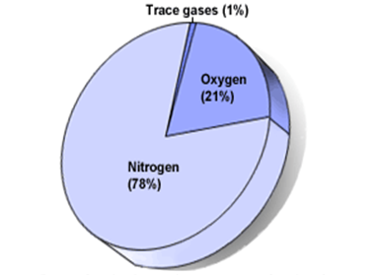
ATMOSPHERIC CONTENT
Composition of air :-
78% - Nitrogen
21% - Oxygen
1% - Other Gases (argon, carbon dioxide, hydrogen, helium, neon, etc.)
OXYGEN
Human breathing
Fuel combustion → keep aircraft flying

Slide 9
PHYSICS OF THE ATMOSPHERE
Before examining the fundamental laws of flight, several basic facts must be considered. An aircraft operates in the air. Therefore, those properties of air that affect the control and performance of an aircraft must be understood.

Slide 10
PRESSURE
Atmospheric pressure is usually defined as the force exerted against the earth’s surface by the weight of the air above that surface.
Weight is force applied to an area that results in pressure. Force (F) equals area (A) times pressure (P), or F = AP.
Therefore, to find the amount of pressure, divide area into force (P = F/A). A column of air (one square inch) extending from sea level to the top of the atmosphere weighs approximately 14.7 pounds; therefore, atmospheric pressure is stated in pounds per square inch (psi). Thus, atmospheric pressure at sea level is 14.7 psi.

Slide 11
Atmospheric pressure is measured with an instrument called a barometer, composed of mercury in a tube that records atmospheric pressure in inches of mercury (Hg).

Slide 12
Atmospheric Pressure
Standard atmospheric pressure at sea level is also known as 1 atmosphere, or 1 atm. The following measurements of standard atmospheric pressure are all equal to each other.
1 atm
14.7 psi
29.92 in Hg
1013.2 hPa
=
1013.2 mb
760 mm Hg
(pounds per
square inch)
=
=
(or 101325
newtons per
square meters
(inches of
mercury)
=
=
(atmosphere)
(millibars)
(millimeters
of mercury)

Slide 13
Atmospheric pressure decreases with increasing altitude.
As an aircraft ascends, atmospheric pressure drops, the quantity of oxygen decreases, and temperature drops.
These changes in altitude affect an aircraft’s performance in such areas as lift and engine horsepower.
The effects of temperature, altitude, and density of air on aircraft performance are covered in the following paragraphs.

Slide 14
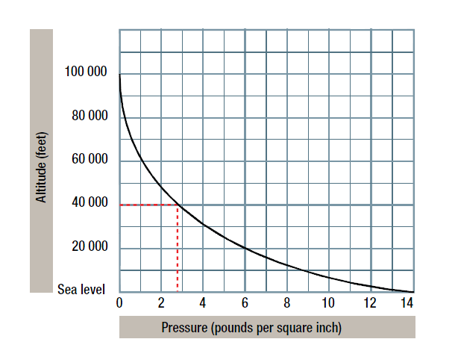

Slide 15
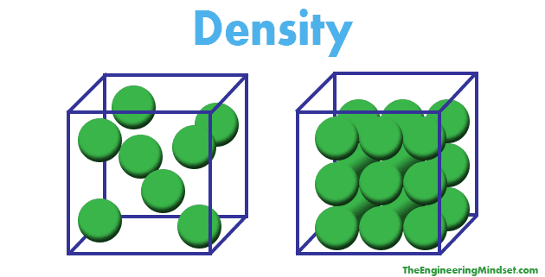
DENSITY
Density is the measurement of how tightly a material is packed together.
Density is the amount of matter in a specific area.

Slide 16
Since air is a mixture of gases, it can be compressed.
If the air in one container is under half as much pressure as an equal amount of air in an identical container, the air under greater pressure is twice as dense as that in the other container.
For the equal weight of air, that which is under the greater pressure occupies only half the volume of that under half the pressure.

Slide 17
The density of gases is governed by the following rules:
1. Density varies in direct proportion with the pressure.
2. Density varies inversely with the temperature.
air at high altitudes is less dense than air at low altitudes
and a mass of hot air is less dense than a mass of cool air.
Changes in density affect the aerodynamic performance of aircraft with the same horsepower. An aircraft can fly faster at a high altitude where the air density is low than at a low altitude where the density is greater. This is because air offers less resistance to the aircraft when it contains a smaller number of air particles per unit of volume.

Slide 18
Density at sea level is 1.225 kg/m³

Slide 19
HUMIDITY
Humidity is the amount of water vapor in the air.
Humidity is the presence of water vapor in the atmosphere.
The maximum amount of water vapor that air can hold varies with the temperature. The higher the temperature of the air, the more water vapor it can absorb.

Slide 20
The actual amount of water vapour in the atmosphere being dependent on the air temperature of the day
So on hot days air can hold more water vapour.

Slide 21
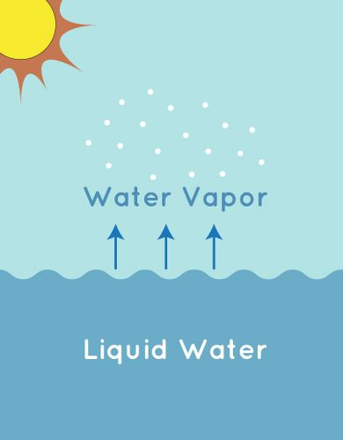
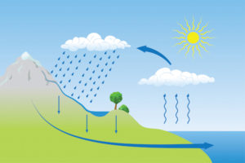

Slide 22
HOW DO WE MEASURE HUMIDITY?
There are a couple of different means of calculating humidity in absolute and relative terms.
1. Absolute humidity
2. Relative humidity

Slide 23
Absolute humidity –
Absolute humidity is the weight of water vapor in a unit volume of air.
Absolute humidity is simply the total mass of water vapor in a given air volume
Absolute humidity is the amount of water vapour present in a given mass of air at a particular time and temperature

Slide 24
Absolute humidity is the measure of water vapor (moisture) in the air, regardless of temperature.
It is expressed as grams of moisture per cubic meter of air (g/m3).

Slide 25
Relative humidity –
Relative humidity is the ratio, in percent, of the moisture actually in the air to the moisture it would hold if it were saturated at the same temperature and pressure.
OR
relative humidity is the ratio of the amount of water vapour present in the atmosphere to the maximum amount of water vapour the air can hold

Slide 26
Relative humidity also measures water vapor but RELATIVE to the temperature of the air.
On damp days, the air density is less than on dry days. For this reason, an aircraft requires a longer runway for takeoff on damp days than it does on dry days.

Slide 27
The density of the air varies inversely with the humidity.
DENSITY increases - HUMIDITY Decreases
DENSITY Decreases – HUMIDITY Increases

Slide 28
LAYERS OF THE ATMOSPHERE
The different layers of the atmosphere
The atmosphere can be divided into layers based on its temperature.
TROPOSPHERE
STRATOSPHERE
MESOSPHERE
THERMOSPHERE AND IONOSPHERE
EXOSPHERE

Slide 29
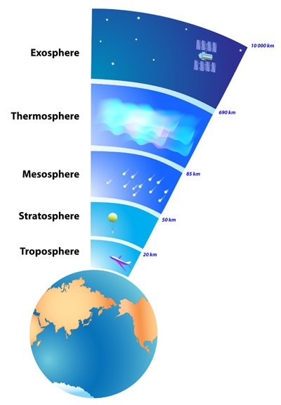
LAYERS OF THE ATMOSPHERE

Slide 30
TROPOSPHERE
This is the lowest part of the atmosphere.
Troposphere: 0 to 12 km (0 to 7 miles)
It extends from Earth's surface to an average height of about 12 km (7.5 mi; 39,000 ft),
It contains most of our weather - clouds, rain, snow.
In this part of the atmosphere the temperature gets colder as the distance above the earth increases, by about 6.5°C per kilometre.
The troposphere contains about 75% of all of the air in the atmosphere, and almost all of the water vapour (which forms clouds and rain).

Slide 31
The decrease in temperature with height is a result of the decreasing pressure.
The top of the troposphere is called the tropopause.
Most civilian aviation takes place in the troposphere
in which temperature decreases as altitude increases.
The rate of change is somewhat constant at about –2 °C or –3.5 °F for every 1 000 feet of increase in altitude.
The upper boundary of the troposphere is the tropopause.
It is characterized as a zone of relatively constant temperature of –57 °C or –69 °F.

Slide 32
STRATOSPHERE
The next layer up is called the stratosphere.
Stratosphere: 12 to 50 km (7 to 31 miles)
The layer between the troposphere and stratosphere is called tropopause.
The stratosphere extends from the top of the troposphere to about 50 km (31 miles) above the ground.
ozone layer is found within the stratosphere.
The ozone layer sits in the stratosphere between 15 km and 30 km above the earth
Ozone molecules in this layer absorb high-energy ultraviolet (UV) light from the Sun, converting the UV energy into heat.
The ozone layer protects the Earth against most UV coming from the sun.

Slide 33
MESOSPHERE
The mesosphere is the third highest layer of Earth's atmosphere
The region above the stratosphere is called the mesosphere.
Mesosphere: 50 to 80 km (31 to 50 miles)
It extends upward to a height of about 85 km (53 miles) above our planet.
Temperatures once again grow colder as you rise up through the mesosphere.
The coldest temperatures in earth's atmosphere, about -90° c
(-130° f), are found near the top of this layer.
The layer between the stratosphere and mesosphere is called stratopause.
As the altitude increases the temp decreases.

Slide 34
THERMOSPHERE
The thermosphere is the second-highest layer of Earth's atmosphere.
The thermosphere lies above the mesopause,
Thermosphere: 80 to 700 km (50 to 440 miles)
Karman line is the boundary between Earth's atmosphere and outer space.
Karman line lies 100 km above the mean sea level.
in which temperatures again increase with height.
As the altitude increases temp also the increases.
It is this layer where many of the satellites orbiting the earth are present.
The layer between the mesosphere and thermosphere is called mesopause.

Slide 35
EXOSPHERE
The exosphere is the outermost layer of Earth's atmosphere (i.e. the upper limit of the atmosphere).
Exosphere: 700 to 10,000 km (440 to 6,200 miles)
It extends from the thermopause, at the top of the thermosphere at an altitude of about 700 km above sea level, to about 10,000 km (200 mies; 33,000,000 ft).
The layer between the thermosphere and exosphere is called thermopause.

Slide 36
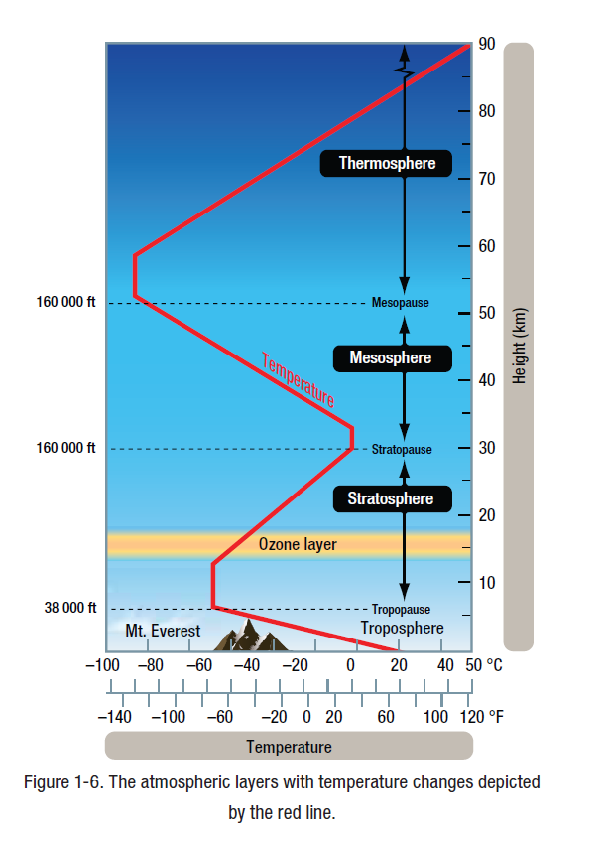

Slide 37
The International Standard Atmosphere (ISA)
The International Standard Atmosphere (ISA) is a static atmospheric model of how the pressure, temperature, density, and viscosity of the Earth's atmosphere change over a wide range of altitudes or elevations.
It has been established to provide a common reference for temperature and pressure and consists of tables of values at various altitudes

Slide 38
As atmospheric conditions vary around the world due to changes in the properties of the atmosphere. It was internationally agreed to have a Standard Atmosphere covering temperature, pressure and density for varying altitudes, in order to compare aircraft performance and calibrate aircraft instruments.
The International Civil Aviation Organization (ICAO) is a specialized agency of the United Nations that changes the principles and techniques of international air navigation, and fosters the planning and development of international air transport to ensure safe and orderly growth

Slide 39
The International Standard Atmosphere (ISA) was agreed by the International Civil Aviation Organisation (ICAO) and set at mean sea level with values of.
Pressure : 1013.25 millibar (mb)
14.69 PSI
29.92 inches of mercury or 76 cm of mercury
Density : 1.225 kg/m3
0.077 lbs/ft3
Temperature : 15°C
59°F
288K

Slide 40
International Civil Aviation Organization (ICAO)
International Organization for Standardization (ISO)
The International Standard Atmosphere (ISA)

Slide 41
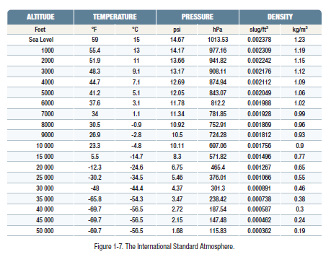

Slide 42
LAPSE RATE
The lapse rate is the rate at which an atmospheric variable, normally temperature in Earth Atmosphere, falls with Altitude.
The temperature lapse rate below the tropopause is 2°C per 1000 ft.

Slide 43
THANK YOU
Prepared By :
Mr. Pranav Thorave
Hindustan Aerospace And Engineering Pune.

